Slide 1
Boosting Algorithms
Kuppusamy S

Slide 2
Purpose and Types of Boosting Algo
We need boosting algorithms to improve the accuracy of weak classifiers by combining them into a stronger model, thereby enhancing overall predictive performance.
There are:
Ada Boosting
XG Boosting
LG Boosting

Slide 3
1.Ada Boost
Definition:
AdaBoost, short for Adaptive Boosting, is a machine learning algorithm that
combines multiple weak classifiers into a strong classifier by adjusting the
weights of misclassified points.
Def: Weak learners:
AdaBoost uses simple models called "weak learners" (like decision stumps)
which are individually not very accurate, but when combined together,
they can create a strong learner.
Origin:
Developed by Yoav Freund and Robert Schapire in 1995.
Purpose:
Boosts the performance of algorithms by focusing on the most challenging cases.

Slide 4
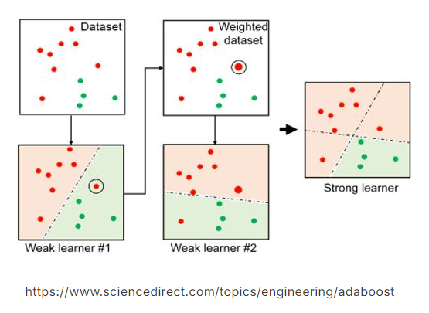
Ada Boost – How it works

Slide 5
Ada Boost – Advantages & Limitations
Advantages:
High accuracy: Often improves the performance of weak learners.
Versatility: Can be used with various base classifiers.
No overfitting: Less prone to overfitting compared to other algorithms.
Limitations:
Sensitive to noisy data: Performance may degrade with outliers.
Computationally expensive: Requires multiple iterations for convergence.
Weakness: Effectiveness depends on the choice of base classifiers.

Slide 6
Ada Boost - Applications
Image Recognition: Used in face detection and object classification in autonomous systems.
Text Classification: Enhances spam detection and sentiment analysis in emails and social media.
Healthcare: Improves disease prediction and medical image analysis (e.g., tumor detection).
Fraud Detection: Identifies fraudulent activities in financial transactions and insurance claims.
Customer Behavior: Predicts customer churn and enhances recommendation systems.
Speech Recognition: Improves accuracy in voice command recognition and speaker identification.
Finance: Aids in stock price prediction and risk assessment.

Slide 7
2.XG Boost
Definition:
XGBoost (Extreme Gradient Boosting) is a powerful machine learning algorithm
based on gradient boosting, designed for speed and performance.
Origin:
Developed by Tianqi Chen in 2014 as part of the Distributed (Deep) Machine Learning
Community (DMLC) group. It quickly gained popularity for its efficiency and scalability.
Purpose:
XGBoost is designed to optimize both the computational speed and predictive accuracy
of models, particularly in large-scale and high-dimensional data settings.

Slide 8
XGBoost, short for "Extreme Gradient Boosting," is a machine learning algorithm that combines multiple decision trees in a sequential manner,
where each new tree learns from the errors of the previous ones, progressively improving the overall prediction accuracy by focusing on the areas where the previous model made mistakes,
Simple words : XGBoost is a boosting algorithm that uses bagging, which trains multiple decision trees and then combines the results.
XGBoost uses decision trees as its base learners combining them sequentially to improve the model's performance.

Slide 9
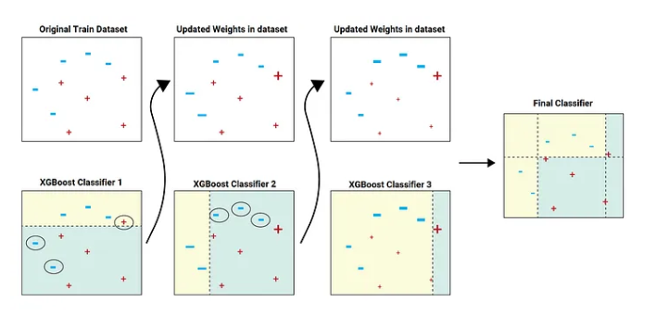
XG Boost– How it works

Slide 10
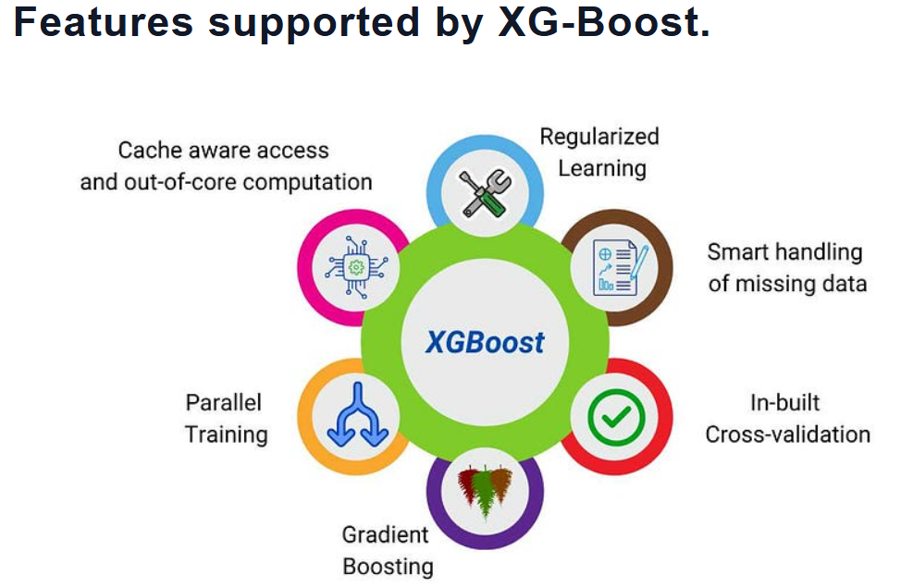

Slide 11
XG Boost - Applications
Finance: Widely used in predicting stock prices, credit scoring, and detecting fraudulent transactions.
Healthcare: Applied in disease prediction, patient outcome forecasting, and medical image analysis.
Marketing: Helps in customer segmentation, churn prediction, and personalized recommendation systems.
Competition Success: Frequently used by data scientists to win machine learning competitions on platforms like Kaggle.
Retail: Used in demand forecasting, inventory management, and optimizing supply chain processes.

Slide 12
XG Boost – Advantages & Limitations
Advantages:
High Performance: Fast execution and high accuracy, making it suitable for large datasets.
Regularization: Includes built-in L1 and L2 regularization, reducing the risk of overfitting.
Flexibility: Supports various objective functions and can be used for regression, classification.
Parallel Processing: Efficiently handles large datasets with parallel computing, making it scalable.
Limitations:
Complexity: Can be complex to tune and requires careful parameter optimization for best results.
Overfitting Risk: Although mitigated by regularization, there’s still a risk of overfitting, especially small datasets
Resource Intensive: Requires significant computational resources and memory, particularly with large datasets.

Slide 13
3.LG Boost
Definition:
LightGBM (Light Gradient Boosting Machine) is a gradient boosting framework designed for high efficiency, speed, and scalability, particularly with large datasets.
Origin: Developed by Microsoft in 2016, LightGBM is part of the open-source Distributed Machine Learning Toolkit (DMTK) and was created to address the limitations of other gradient boosting methods.
Purpose: LightGBM aims to provide faster training times and lower memory usage while maintaining or improving model accuracy, making it ideal for large-scale data applications.

Slide 14
Simple word:
"LG Boosting" refers to the "Light Gradient Boosting Machine" algorithm,
which is a type of machine learning technique that combines multiple
weak prediction models (like small decision trees) to create a stronger,
more accurate prediction model by sequentially adding new trees that focus on correcting the errors of the previous ones,

Slide 15
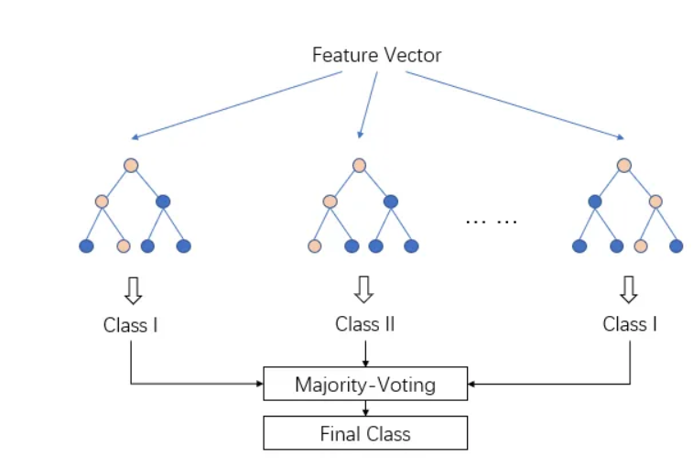

Slide 16
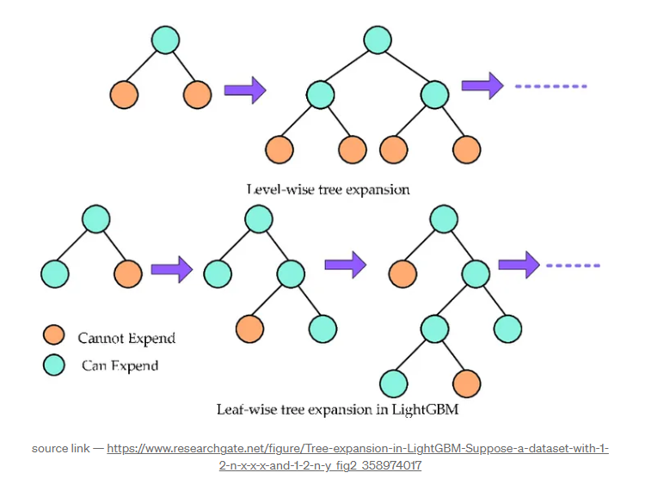
LG Boost– How it works

Slide 17
LG Boost – Advantages & Limitations
Advantages:
High Speed: Optimized for fast training, especially with large datasets and high-dimensional data.
Efficiency: Consumes less memory and computational resources compared to other boosting algorithms.
Scalability: Supports distributed training, making it suitable for big data scenarios.
Accuracy: Provides competitive accuracy, particularly with large and complex datasets.
Limitations:
Complexity in Tuning: Like other boosting algorithms, it requires careful tuning of hyperparameters for
optimal performance.
Sensitivity to Overfitting: Despite regularization, there’s a risk of overfitting, particularly with small datasets.
Limited Interpretability: As with most gradient boosting methods, the resulting models can be
difficult to interpret.

Slide 18
LG Boost - Applications
Finance:
Used in credit scoring, risk assessment, and fraud detection, thanks to its speed and accuracy with large
datasets.
E-commerce:
Applied in product recommendation systems, customer segmentation, and sales forecasting.
Healthcare:
Employed in predictive modeling for patient outcomes, disease diagnosis, and genomic data analysis.
Marketing:
Helps in predicting customer churn, optimizing marketing campaigns, and personalizing user experiences.
Technology:
Frequently used in machine learning competitions for tasks like click prediction, ranking, and anomaly
detection due to its scalability and performance.

